Slide 1
Personal exposure to NO and NO₂ from passing vehicles
Dr. Mark Peckham & Jamie Parnell

Slide 2
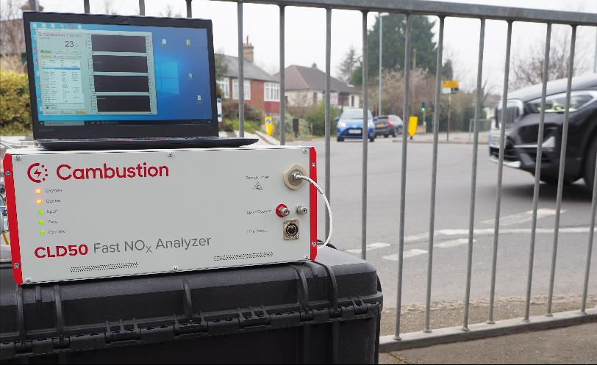
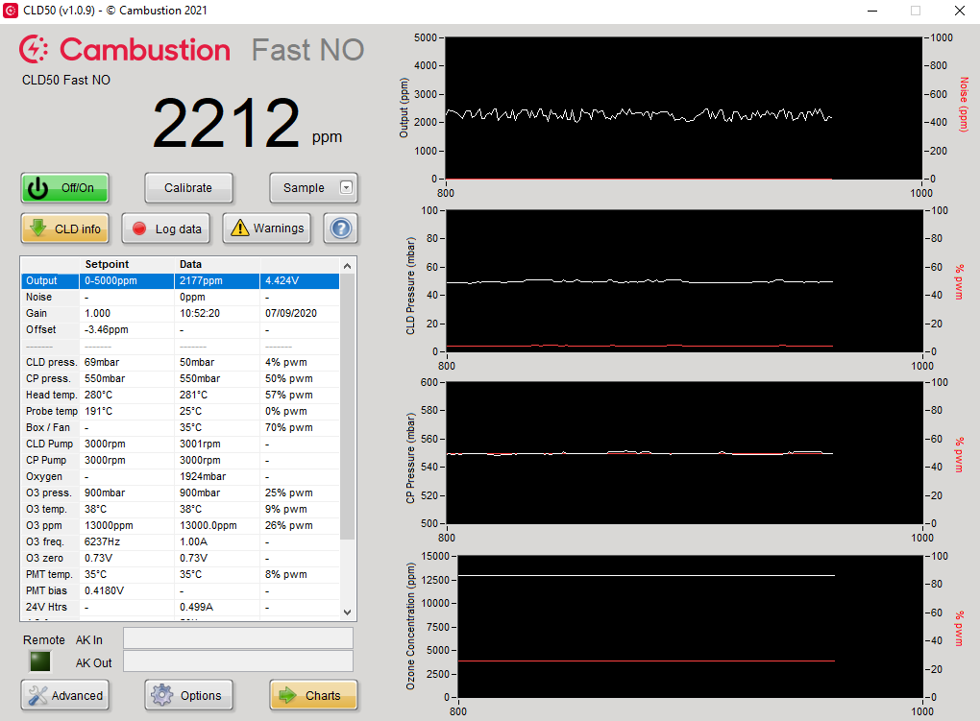
CLD50 for [NO] & [NO₂] fast measurements
Time response ~ 15ms
Sensitivity 5 ppb – 5,000 ppm across 8 detection ranges
Portable ( 14kg / 45×37×13 cm )
Built-in 10Hz data logger
Data output: – 0 – 10V analogue DC on 10 & 100 Hz BNC
AK protocol (option)

Slide 3
Child transient NO_{x} exposure

Slide 4
Capturing “gross emitters”

Slide 5
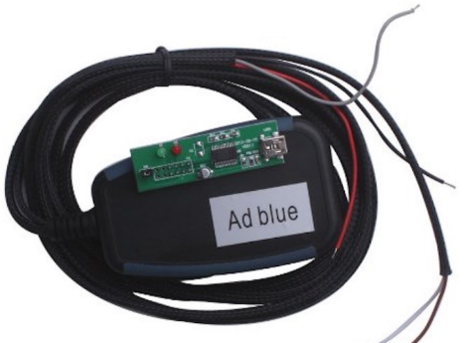
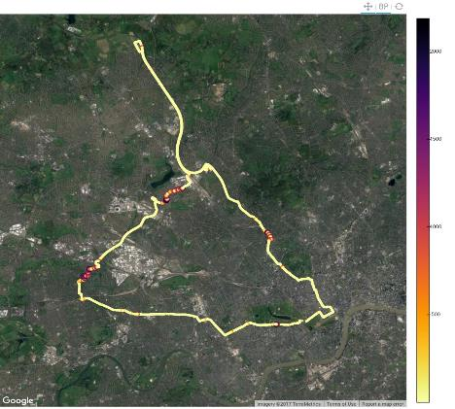
Capturing “gross emitters”
Used by:
Law enforcement and government to catch SCR system “defeat devices”
Local government to check which vehicles are polluting the most in Clean Air Zones

Slide 6
NO_{x} from passing Turbostar diesel train

Slide 7
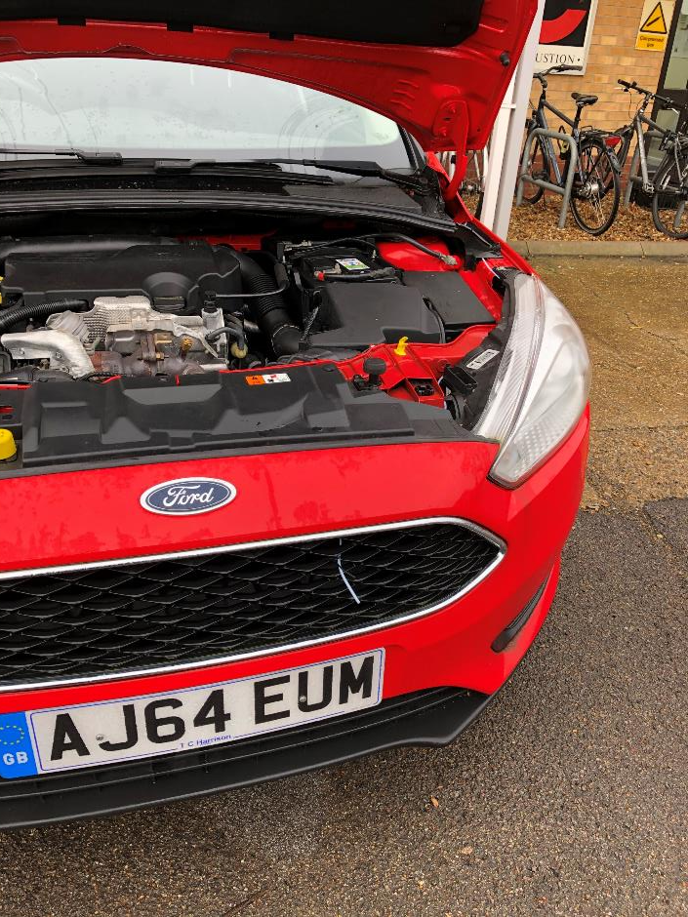
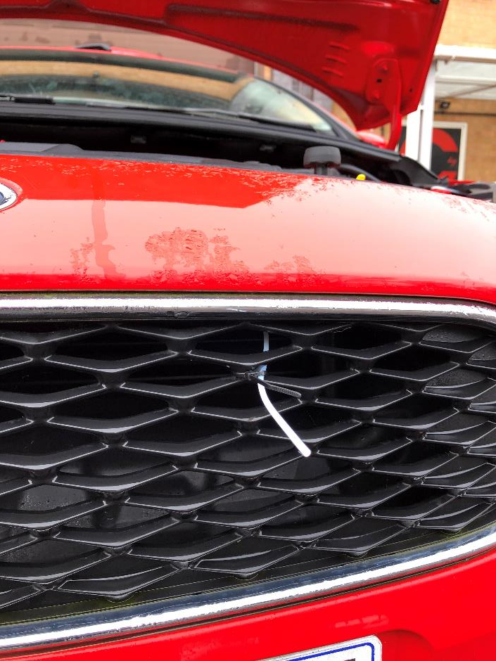
Measurement of pollution from the vehicle in front…

Slide 8
NO & NO₂ urban chase studies

Slide 9
Chase study of bus stop manoeuvre

Slide 10
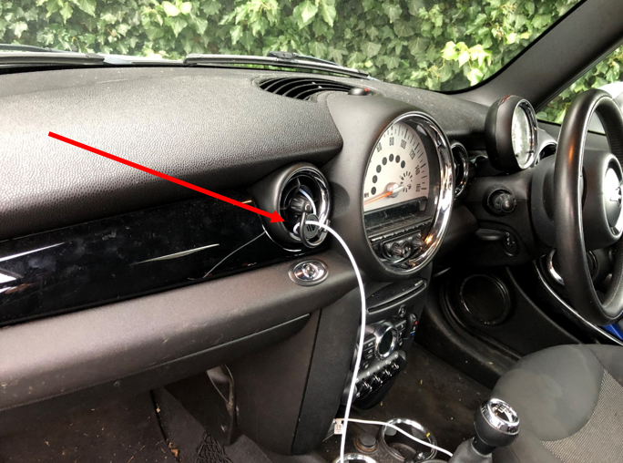
Cabin Air Quality

Slide 11
Van emissions entering cabin air vent

Slide 12
Roadside dispersion model validation

Slide 13
Cyclist NOx exposure

Slide 14
Medical respiratory research

